Slide 1
Getting Started with ASP.NET Core
Bhawna Gunwani
Corporate Trainer and Consultant

Slide 2
Introducing ASP.NET Core

Slide 3
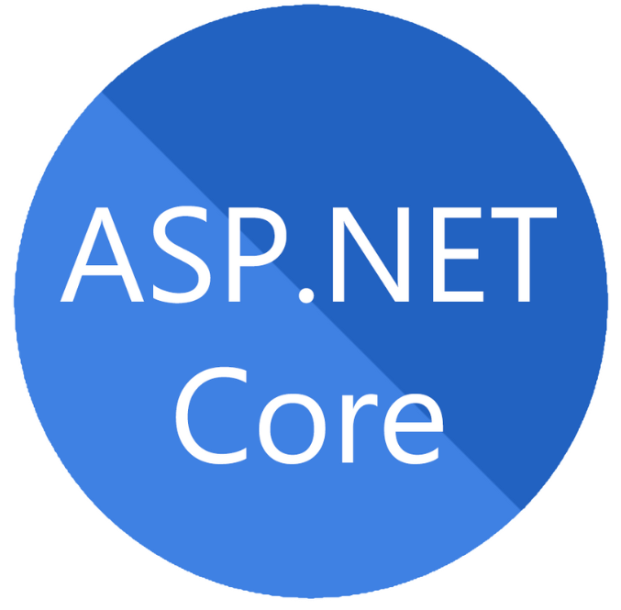
Introducing ASP.NET Core
ASP.NET Core is open-source and cross-platform framework.
An unified framework for building web UI and web APIs.
It has built-in dependency injection.
It does have high degree of compatibility with ASP.NET.
ASP.NET Core is also perfectly suited for Docker containers.

Slide 4
Features of ASP.NET Core
Less Code
High Performance
Easy Maintenance
03
02
04
Cloud Based Application Development
Support
Cross-Platform Support
01
05

Slide 5
ASP.NET vs. ASP.NET Core
Domain | ASP.NET | ASP.NET Core
Platform Support | Asp.Net is Built for Windows | Runs on Windows, Mac and Linux
Architecture | Based on .NET Framework | Based on .NET Core
Dependencies | Less Control over dependencies | Strict control over dependencies
File Support | WCF, WF, WPF, VB, Web Config | No support for Global.asax, Web config
Components | WebForms, MVC and Web API | MVC, WebAPI, Razor Pages, and Blazor
Visual Studio | Support of all versions | Support of latest versions from 2015

Slide 6
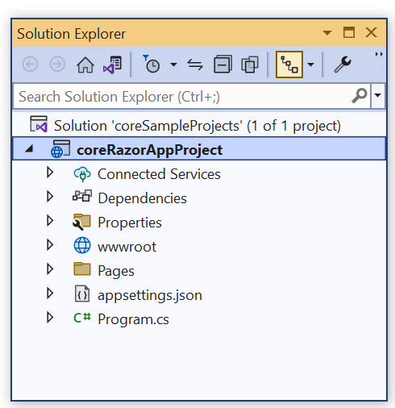
ASP.NET Core Project Folder
Details of the default project can be seen in the solution explorer.
It displays all the projects related to a single solution.
Folder structure is organized in a hierarchical manner.
Each level representing a different aspect of the application.

Slide 7
ASP.NET Core Project Folder Structure
Here is a brief overview of the different levels and their contents:
Solution Level:
- The highest level is the solution level which represents entire application.
- Contains solution file, which is used to manage the entire application.
Project Level:
- Represents a specific component or module of the application.
- Common project types include web apps, class libraries, and test projects.

Slide 8
ASP.NET Core Project Folder Structure
Directory Level:
- Within each project, there are directories that organize files and resources.
- For example, “Views” directory contains HTML templates.
File Level:
- At the lowest level of the project structure are individual files.
- These files can include code files, configuration files, asset and more.

Slide 9
DEMO Building a Basic .NET Core Web Application with ASP.NET Core

Slide 10
MVC Pattern

Slide 11
Introduction to ASP.NET MVC
ASP.NET MVC is an open-source software from Microsoft.
MVC divides an application's implementation into three component roles:
- Models, Views, and Controllers.
Provides an alternative to ASP.NET Web Forms pattern.
ASP.NET MVC has better performance than Web Forms.
Enables developers to create web applications and websites through the use of HTML, CSS, JavaScript, jQuery besides others.

Slide 12
Web App Components and MVC Pattern
Model Classes
Model
View
Controller
UI Components
Request and Relay

Slide 13
Understanding MVC Pattern
MVC stands for Model, View, and Controller.
Separates an application into three components - Model, View, and Controller.
View
Send request
Display
Renders
Controller
Model
Manipulate

Slide 14
Model
Model represents the shape of the data.
A class that represents the data and business logic of the application.
Responsible for defining data entities, validating input, and DB operations.
Used in conjunction with data access technologies such as Entity Framework, LINQ or SQ.
Model represents the data

Slide 15
View
View is responsible for rendering the user interface of the application.
View display model data to the user and also enables them to modify them.
Defined as an HTML template that includes server-side code to render data.
Can use technologies to render HTML, including Razor, ASPX, and others.
Client-side technologies such as JavaScript and CSS can be used to enhance UI.
View represents the User Interface

Slide 16
Controller
Responsible for handling user input and updating the model and the view.
It is the component that handles requests from the client,
Performs operations on the model, and selects the view to render the response.
Defined as a class that inherits from the base controller class in ASP.NET MVC.
Includes action methods that correspond to user requests and perform operations on the model.
Controller represents the request handler

Slide 17
Model-View-Controller Communication

Slide 18
Model-View-Controller Communication
BROWSER
OUTPUT
Request
Response
CONTROLLER
Rendering the Data
Exchange Data
VIEW
MODEL

Slide 19
Model-View-Controller Communication
Model to Model:
We can communicate from Model to Model via parameters/composition.
Model to View:
To communicate Model to View, follow the path: Model > Controller > View.
We can’t directly move from Model to View.
First, the Model object is made in the Controller and then it is passed to View.

Slide 20
Model-View-Controller Communication
We can pass the data or communicate from Model to View by these three steps:
- Take the object in the action of a Controller.
- Pass Model object as a parameter to View.
- Use @model to include Model on the View page.

Slide 21
Model-View-Controller Communication
Model to Controller:
Create an object of Model class in Controller to access the Model in Controller.
View to Model:
To communicate View to Model, follow the path: View > Controller > Model.
We can’t directly move from View to Model.
First, you have to submit data to the controller and then pass it to the model.

Slide 22
Model-View-Controller Communication
To pass the data from View to Model, you have to follow these three steps:
- Submit HTML form to a Controller.
- Create an object of Model in Controller.
- Pass Values to the Model object.

Slide 23
Model-View-Controller Communication
View to View:
We can move from one view to another view by using partial views.
View to Controller:
Move data from view to controller by submitting forms to controllers or by:
- JSON
- AJAX Calls
- JavaScript
- Partial Views

Slide 24
Model-View-Controller Communication
Controller to Model:
We can move from Controller to Model just like we moved from Model to Controller.
Controller to View:
Move data from Controller to View in following ways:
- By using ViewBag
- ViewData
- TempData

Slide 25
Model-View-Controller Communication
Controller to Controller:
We can move from one Controller to another by using RedirectToAction();
And then pass the name of the specific action.

Slide 26
DEMO Handling Requests in .NET Core MVC

Slide 27
Action Methods

Slide 28
Action Methods
An action is a method that responds to user action/activity.
Any method in a controller which has public modifier acts as an action method.
They are like any other normal methods with the following restrictions:
- Action method must be public. It cannot be private or protected.
- Action method cannot be overloaded.
- Action method cannot be a static method.

Slide 29
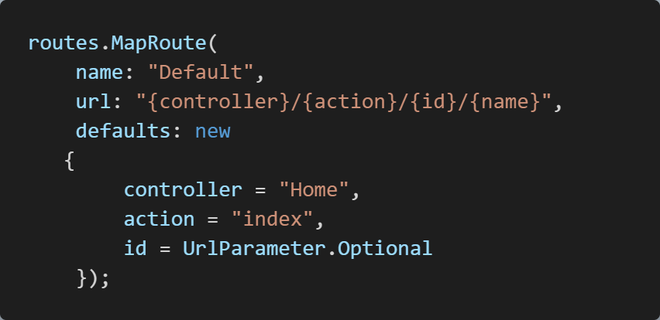
Default Action Methods
Every controller can have default action method as per configured route in the RouteConfig.
By default, the Index() method is a default action method for any controller.
Also, you can change default action name as per requirement in RouteConfig.

Slide 30
Result Types

Slide 31
Action Result
MVC includes Result classes, which can be returned from an action method.
Result classes represents types of responses, such as HTML, string, JSON etc.
ActionResult class is a base class of all the above result classes,
so it can be the return type of action method that returns any result.
However, you can specify result class as a return type of action method.
The base controller class includes the View() method along with other methods that return a particular types of result.

Slide 32
Action Result
Controller
Request or Response
Different types of Action Result
View

Slide 33
Action Result
This table lists all the result classes with their base controller methods:
Result Class | Description | Base Controller Method
ViewResult | Represents HTML and markup. | View()
EmptyResult | Represents No response.
ContentResult | Result string literal. | Content()
FileContentResult | Represents the content of a file. | File()
RedirectResult | Represents a redirection to a new URL. | Redirect()
JsonResult | Represent JSON that can be used in AJAX. | Json()
PartialViewResult | Returns HTML from Partial view. | PartialView()
JavaScriptResult | Represents a JavaScript script. | JavaScript()
HttpUnauthorizedResult | Represents HTTP 403 response.

Slide 34
Razor View Engine

Slide 35
Razor View Engine
Responsible for producing HTML response when invoked by Controller Action.
Controller Action methods returns responses, which are called as Action Results.
ViewResult is the ActionResult which produces the HTML Response.
ViewResults are produced by the View Engine.
When the Controller Action method invokes the view() or PartivalView(),
it invokes the View Engine, which produces the HTML Response.

Slide 36
Razor View Engine
A default View Engine for the ASP.NET Core apps.
Used to generate views returned to client's browser in response to request.
It is a powerful and flexible templating engine.
With this, it is easier to create dynamic web pages in ASP.NET Core.

Slide 37
Razor View Engine
HTML + C# Code
Pure HTML
View Engine
RazorView
Browser

Slide 38
Razor Syntax

Slide 39
Razor Syntax
Razor is a markup syntax for embedding .NET based code into webpages.
Razor syntax consists of Razor markup, C#, and HTML.
Files containing Razor generally have a .cshtml file extension.
Similar to the templating engines of JavaScript single-page application (SPA) frameworks, such as Angular, React etc.
Razor supports C# and uses the @ symbol to transition from HTML to C#.

Slide 40


Razor Syntax
To escape an @ symbol in Razor markup, use a second @ symbol.
The code is rendered in HTML with a single @ symbol.

Slide 41
Layout View

Slide 42
Layout View
The layouts are like the master pages in Webforms applications.
Defines the common layout or structure of multiple views in an application.
It allows you to define a consistent layout such as a header, footer, and navigation menu, which can be reused across multiple views.
Used to define the structure of the HTML page and may contain placeholders for the content that will be displayed by the views.

Slide 43
Layout View
Nowadays, almost all web applications have the following sections.
Website Header
Website Footer
Navigation Menus
Instead of putting all the sections (i.e. the HTML) in each and every view pages,
it is always better and advisable to put them in a layout view.
Then inherit that layout view in views where you want that look and feel.

Slide 44
Layout View
Website Header
Left Navigation Menus
Main Content Area
Website Footer

Slide 45
Sections View

Slide 46
Sections View
Sections are a feature of layout views.
Defines and render blocks of content from individual views that use the layout.
Sections provide a way for views to specify content that should be inserted into specific parts of the layout view, such as a sidebar or a footer.
Useful when you want to reuse a common layout across multiple views.
To define a section, you can use Razor syntax and @RenderSection() directive.

Slide 47
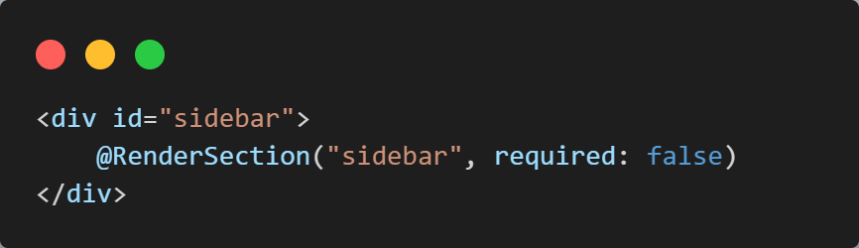
Sections View
For Example:
To define a section for a sidebar in a layout view, Use the following code:

Slide 48
ViewStart

Slide 49
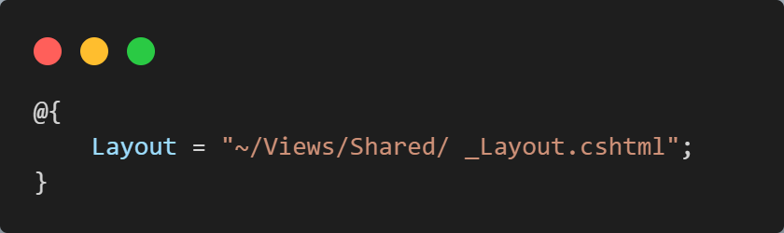
ViewStart
Allows you to define default settings and configurations for all the views.
It is a partial view that is executed before any other view is rendered,
Can be used to set common properties such as the layout or master page, the view engine to use, or the default model type.
For example, setting a default layout for all views in your application:

Slide 50
HTML Helpers

Slide 51
HTML Helpers
The HtmlHelper class renders HTML controls in the razor view.
Binds model object to HTML controls to display value of model properties into those controls.
Assigns the value of controls to model properties while submitting a web form.
So, always use HtmlHelper class in razor view instead of writing HTML tags.

Slide 52
HTML Helpers
This table lists HtmlHelper methods and HTML control each method renders:
Extension Method | Strongly typed Method | HTML Control
Html.ActionLink() | NA | <a></a>
Html.TextBox() | Html.TextBoxFor() | <input type="textbox">
Html.TextArea() | Html.TextAreaFor() | <input type="textarea">
Html.CheckBox() | Html.CheckBoxFor() | <input type="checkbox">
Html.RadioButton() | Html.RadioButtonFor() | <input type="radio">
Html.DropDownList() | Html.DropDownListFor() | <select> <option> </select>
Html.ListBox() | Html.ListBoxFor() | multi-select list box: <select>
Html.Hidden() | Html.HiddenFor() | <input type="hidden">

Slide 53
Tag Helpers

Slide 54
Tag Helper
Tag helper is a new feature in ASP.NET MVC.
Enables server-side code to create and render HTML elements in Razor View.
It is a feature of Razor View engine.
C# classes which participate in view generation by creating the HTML elements.
We can change the content of HTML element and add attributes to element.
It is very similar to HTML helper in ASP.NET MVC.

Slide 55
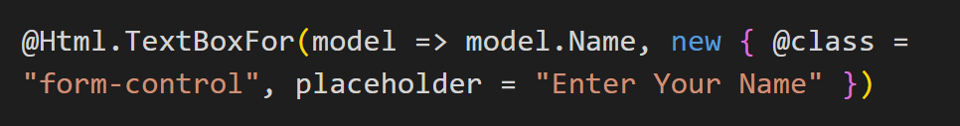
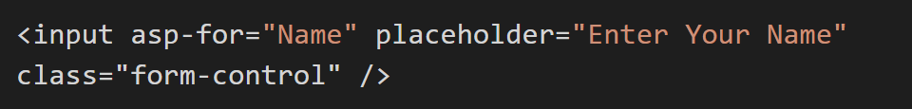
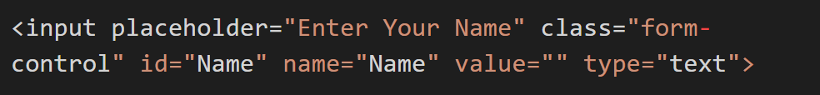
Tag Helper
HTML Helper:
Equivalent with Tag Helper:
Equivalent HTML:

Slide 56
Advantages of Tag Helper
An HTML-friendly development experience
A rich IntelliSense support
More robust, reliable, and maintainable code
Executes the metadata that sets using Data Annotation in the View Models.

Slide 57
Routing: Convention and Attribute Routing

Slide 58
Convention Routing
Used for defining routes based on conventions, rather than explicitly defining.
Developers define a set of conventions that are used to generate routes for different types of controllers and actions.
Provides a simple way to define routes in an ASP.NET Core application.
URL pattern is generated based on the names of the controller and action.

Slide 59
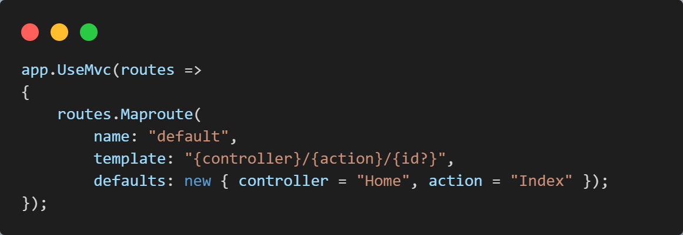
Convention Routing
For Example:
Notes:
This code sets up a default route that maps URLs in the format of /{controller}/{action}/{id}.
When a request arrives, the routing middleware uses this route definition to match the incoming URL to the
appropriate controller and action method.

Slide 60
Attribute Routing
A technique used for defining routes directly in controller code using attributes.
Developers can specify URL pattern for a action method using attributes,
instead of relying on conventions or explicit route definitions.
[Route] attribute is used to specify the URL pattern for an action method.
By specifying the route directly in the controller code, developers can have fine-grained control over the URL patterns for each action method.

Slide 61
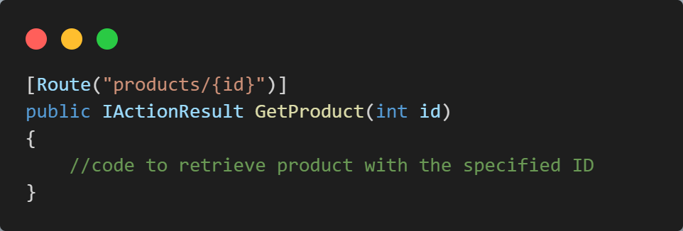
Attribute Routing
For Example:
Notes:
In this example, the [Route] attribute specifies that the GetProduct method should be invoked for URLs in the format of /products/{id}.
The {id} placeholder in the URL pattern is replaced with the value of the id parameter.

Slide 62
DEMO Configure Routing in ASP.NET Core

Slide 63
Data Passing Techniques

Slide 64
Data Passing Techniques
The best method to pass the data to the view from the controller is:
- through the help of model classes which are normally known as view class.
Since in the interface, we normally use the strongly type views;
So, it is easy to access the object or model which need to pass controller.
We can perform this operation with the help of the different type of data passing techniques.

Slide 65
Data Passing Techniques
Following are the object which store values and transfer it from one place to other:
Data Passing Techniques
ViewData
ViewBag
TempData
Session
Cookies
QuerySring

Slide 66
ViewData

Slide 67
ViewData
Used to pass the data from controller action to a view.
Works on the principle of Key-value pairs.
This type of binding is known as loosely binding.
We can pass data like normal integer, string, even though you can pass objects.
ViewData only transfers data from controller to view, not vice-versa. It is valid only during the current request.
@ViewData[“Name”]
@ViewData[“Name”]=“John”
ViewData
View
Controller

Slide 68
ViewBag

Slide 69
ViewBag
ViewBag is used to transfer temporary data.
Data is not included in the model from the controller to the view.
Internally, it is a dynamic type property of the ControllerBase class which is base class of the Controller class.
Often used for simple scenarios where a strongly typed model is not required.
@ViewBag.Name
@ViewBag.Name =“John”
ViewBag
View
Controller

Slide 70
TempData

Slide 71
TempData
Used to transfer data from view to the controller, the controller to the view, or from an action method to another of the same or a different controller.
Temporarily saves data and deletes it automatically after a value is recovered.
TempData can hold the value for several successive queries.
TempData can be used in a couple of scenarios like:
Passing Data from Controller to View.
Transmit data from one activity to another.

Slide 72
TempData
TempData
Controller
Controller
ViewData/ViewBag
TempData
View

Slide 73
Uses of TempData
Used for storing data between two sequential queries.
Similar to a session, which is brief, and uses an internal session to store data.
We can use the loop to access each key and its value sent to the server.
To prevent execution time errors, check the NULL values.
Used in messages like error or validation messages which store a time message.
To supply all values of the template in a third request, we can use Call TempData.Keep().

Slide 74
Session

Slide 75
Session
Sessions provide a way to store user-specific data across requests.
A way to persist data between requests for the same user,
even if they close their browser or leave the application.
When user visits a website, server creates a unique session ID, and sends it to client in cookie.
The client then includes this session ID in subsequent requests.
ASP.NET Core provides a built-in ISession interface.

Slide 76
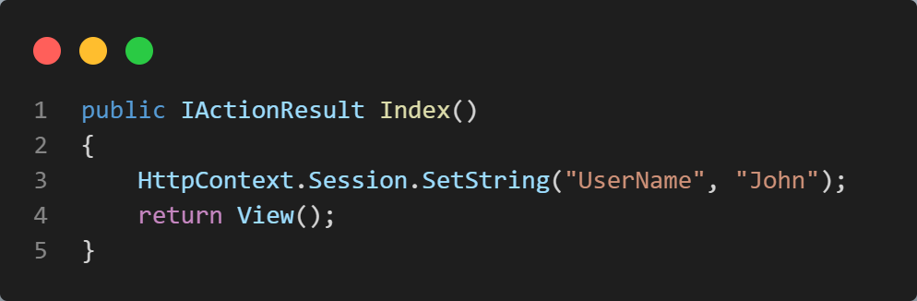
Session
In the below example,
- we are setting a string value "John" in the session with key "UserName".

Slide 77
Cookies

Slide 78
Cookies
A piece of data from a website that is stored within a web browser that the website can retrieve at a later time.
Used to tell the server that users have returned to a particular website.
Specific cookies known as HTTP cookies are used to identify specific users.
ASP.NET Core uses cookies to maintain the session state;
The cookie that contains the session ID is sent to the client with each request.

Slide 79
Cookies
There are two types of Cookies:
Session Cookies
Persistent Cookies
Notes:
Session Cookies:
- When you visit a website, these cookies are stored on computer only for duration of your visit.
- This is destroyed when you leave your browser or move away from a web page.
Persistent Cookies:
- Persistent cookies can store information accessible across multiple sessions.
- Generally, these cookies store login information or preferences.

Slide 80
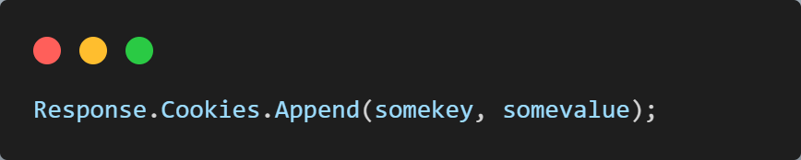
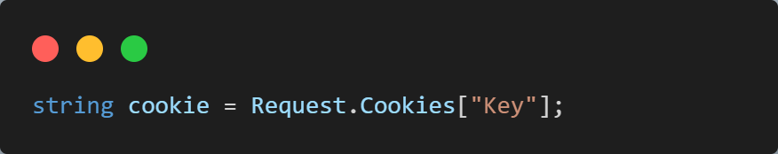
Cookies
Write Cookie:
Read cookie:

Slide 81
QueryString

Slide 82
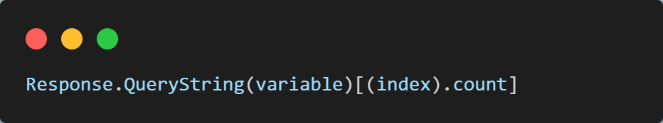
QueryString
A query string is a collection of characters input to a computer or web browser.
Helpful when we want to transfer a value from one page to another.
When we need to pass content between the HTML pages or aspx Web Forms, Query String follows a separating character, usually a Question Mark (?).
It is basically used for identifying data appearing after this separating symbol.

Slide 83
ASP.NET Core Forms

Slide 84
Forms
A key part of building web applications using the ASP.NET Core framework.
Forms allow users to submit data to a server.
Created using HTML helpers, which are methods that generate HTML code that can be used to display and interact with forms.
When a user submits a form, the data is sent to the server using a POST request.
The server then receives the data and can use it to perform the desired action, such as updating a database record.

Slide 85
Model Binding

Slide 86
Model Binding
A mechanism that extracts the data from an HTTP request.
Provides them to the controller action method parameters.
The action method parameters may be simple types:
- like integers, strings, etc., or complex types such as Student, Product, etc.
When a client makes a request to a controller action method,
ASP.NET Core automatically maps the data in the request to the action method's parameters using model binding.

Slide 87
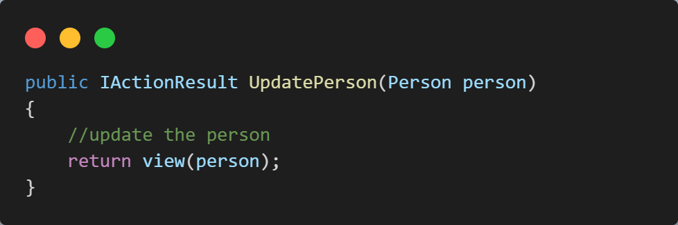
Model Binding
For Example,
Let's say you have an action method that takes a Person object as a parameter:

Slide 88
DEMO Handling Forms Post

Slide 89
Form Validations: Server Side and Client Side

Slide 90
Form Validation
The process of ensuring that user input data submitted through a web form is valid, and meets certain criteria or rules.
Helps to ensure that user input is accurate and consistent with expected format.
There are different types of form validations:
- Server-side Form Validation
- Client-side Form Validation
- Custom Form Validation

Slide 91
Server-Side Form Validation
The process of validating user input data on the server-side, after it has been submitted by the user through a web form.
This is important to ensure that the data is valid, before it is processed.
It can be performed using combination of model binding, data annotations, and the ModelState dictionary.
It prevent malicious users from submitting invalid or harmful data to the server.

Slide 92
Client-Side Form Validation
A Process of validating user input data on the client-side, using JavaScript, before it is submitted to the server.
This is important to provide immediate feedback to the user and reduce the load on the server by preventing unnecessary requests for invalid data.
ASP.NET Core provides built-in support for client-side form validation using the jQuery Validation plugin.

Slide 93
Client-Side Form Validation
Server-Side Validation
HTML Form
Controller Code, etc.
Results
Client-Side Validation
Results
JavaScript
Client-Side
Server-Side

Slide 94
ASP.NET Core Middleware

Slide 95
Middleware Request Pipeline
Requests are processed beginning with request and ending with response.
Pipeline specifies how the application should respond to the HTTP request.
The Request arriving from the browser goes through the pipeline and back.
The individual components that make up the pipeline are called Middleware.

Slide 96
ASP.NET Core Request Pipeline

Slide 97
Middleware Request Pipeline
ASP.NET Application
Request Pipeline
Request
Kestrel
Middleware 1
Middleware 2
Middleware 3
Response
Notes:
First, Http Request arrives at the Application.
The Kestrel Web Server picks up the Request, and creates the httpContext and passes it to the First Middleware in the request pipeline.
First Middleware takes over, process request and passes it to the next Middleware.
This goes on until it reaches the last middleware.
The last one returns the request back to previous middleware, terminating the request pipeline.
Finally, response reaches kestrel, which returns the response back to the client.
Any of the middleware in the request pipeline can terminate the request pipeline by simply not passing the request to the next middleware.

Slide 98
Middleware Request Pipeline
Middleware 1
Middleware 2
Middleware 3
Request
//logic
next();
//more logic
//logic
next();
//more logic
//logic
next();
//more logic
Response

Slide 99
Built-In Middleware

Slide 100
Built-In Middleware
Microsoft introduced many inbuilt middleware with ASP.NET Components.
Middleware | Description
Authentication | Provide the authentication support for the application.
CORS | Used for configures Cross-Origin Resource Sharing.
Diagnostics | It is used to configures diagnostics
HTTPS Redirection | It is used to redirect all HTTP request to the HTTPs Service.
Request Localization | It provides the localization support.
Routing | This middleware provides the definition of the request routes.
HTTP Method Override | Provides us for the incoming POST request
MVC | Handles all requests send or receive from the MVC or Razor pages.

Slide 101
Custom Middleware

Slide 102
Custom Middleware
Custom middleware component is like other .NET class with Invoke() method.
However, in order to execute next middleware in a sequence, it should have RequestDelegate type parameter in the constructor.
Allows developers to execute code before or after request response cycle.

Slide 103
ASP.NET Core Filters

Slide 104
ASP.NET Core Filters
Allow us to run custom code before or after executing the action method.
They provide ways to do common repetitive tasks on our action method.
The filters are invoked on certain stages in the request processing pipeline.
Filters help us to remove duplicate codes in our application.
There are many built-in filters available with ASP.NET Core MVC, and we can create custom filters as well.

Slide 105
ASP.NET Core Filters
An action filter is an attribute that you can apply to a controller action or an entire controller that modifies the way in which the action is executed.
The ASP.NET MVC framework includes several action filters −
OutputCache: Caches the output of a controller action for a specified amount of time.
HandleError: Handles errors raised when a controller action is executed.
Authorize: Enables you to restrict access to a particular user or role.

Slide 106
Types of Filters
The ASP.NET MVC framework supports four different types of filters −
Authorization Filters − Implements the IAuthorizationFilter attribute.
Action Filters − Implements the IActionFilter attribute.
Result Filters − Implements the IResultFilter attribute.
Exception Filters − Implements the IExceptionFilter attribute.

Slide 107
DEMO Creating Custom Filters

Slide 108
Dependency Injection

Slide 109
Dependency Injection
DI is used to achieve loosely coupling between objects,
so that applications can be maintained in an easy manner.
Here, runtime engine automatically injects objects of dependency classes
It injects mainly through the constructor of the Controllers.
Thus, making the job of the developer much easier.
The concept of DI arises from a principle software design called Dependency Inversion Principle.

Slide 110
Dependency Injection
Configuration in Startup Class
Component 1
Dependency Injection (DI)
Interface
Component 2

Slide 111
Loosely Coupled Architecture
Components within a system have minimal dependencies on each other.
Means that component can be upgraded without affecting other components.
Often used in distributed systems.
By decoupling the components, it becomes easier to scale the system.
It also makes the system more resilient to failures, as a failure in one component does not necessarily cause the entire system to fail.

Slide 112
Tightly Coupled Architecture
An architectural style where application components are interdependent.
This means that change in one component will impact other components.
For instance, a bank ATM relies on the hardware, built-in firmware and applications, and the main banking app to enable a consumer to withdraw cash or use ATM-specific services.
The ATM will not function if any of these components fail.
It is generally easier to implement than more loosely coupled architectural styles, but can leave a system more vulnerable to cascading failures.

Slide 113
Tightly and Loosely Coupled Architecture
Loosely Coupled:
Less Interdependency
Tightly Coupled:
More Interdependency

Slide 114

Why is Tightly Coupled Code Bad?
It gives problems during the maintenance phase of the project.
If one component changes then it will affect the other components also.
There will be lots of problems when performing Unit Testing of these components.

Slide 115
Types of Dependency Injection
Services created by Dependency Injection have lifetime which defines 2 things:
When they will be created.
How long they will remain in the memory before they are removed by the Garbage Collector.
Services can have 3 lifetimes:
Transient – created each time they’re requested.
Scoped – created once per client request (connection).
Singleton – only the first time they are requested.

Slide 116
DEMO Implementing Dependency Injection in ASP.NET Core

Slide 117
Built-In Container Service

Slide 118
Built-In IoC Container
ASP.NET Core includes built-in IoC container for automatic DI.
The built-in IoC container is a simple yet effective container.
Responsible for instantiating and injecting dependencies into objects at runtime
It does this by examining the constructors of classes and creating instances of any required dependencies as needed

Slide 119
ASP.NET Core Environment Variables

Slide 120
ASP.NET Core Environment Variables
Environment Variables uses the variable called ASPNETCORE-ENVIRONMENT.
It points towards the runtime environment.
The value of variable usually be a Production, Staging, and Development.
Value is case insensitive in Windows and Mac OS but it is case sensitive on Linux.
Environment variable defines runtime environment for which application runs.
They are mainly used to specify Environment application executing, enabling the application to configure it.

Slide 121
ASP.NET Core Environment Variables
Environment Variables can be set to any of the values:
Development:
-This process will be used during the application development;
-While using Visual Studio, setting will be denoted in project’s debug.
Staging:
- A Pre-Production Environment.
- Used for testing after the application before deployment.

Slide 122
ASP.NET Core Environment Variables
Production:
- Production Environment is used while the application executes during the live process where the end-user works on it.

Slide 123
Exception Handling

Slide 124
Exception Handling
Exception Handling is one of important tasks in the application development cycle.
Below are the effective ways to handle the exceptions in .NET Core:
Exception Handling with Try-Catch Block
Global Exception Handling with Custom Middleware

Slide 125
Exception Handling with Try-Catch
The try block contains the code that may throw an exception,
and the catch block catches the exception and provides a way to handle it.
The finally block is optional and contains code that will be executed regardless of whether an exception is thrown or not.

Slide 126
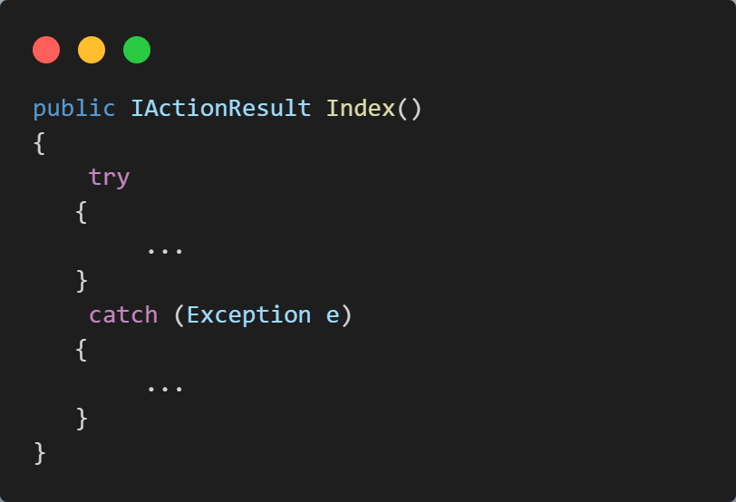
Exception Handling with Try-Catch

Slide 127
Imagine that you have many controllers and actions in your project and then you need to use try-catch for every action in controllers. Sometimes you have to use try-catch in the services. In that case, it increases the lines of code your project and it is not good.
This Problem can be handled by
Global Exception Handling with Custom Middleware

Slide 128
Exception Handling with Custom Middleware
This is a good and effective approach to handling the exception global level.
We could be caught all unhandled exceptions using this exception handler.
Benefit is we could be caught all exceptions in one place, and don’t need to use try-catch in every action to catch errors.
In that case, we need to create custom middleware to handle the exceptions.

Slide 129
Object-Relational Mapping (ORM)

Slide 130
Introducing ORM
ORM stands for object-relational mapping.
ORM is a way to align programming code with database structures.
ORM uses metadata descriptors to create a layer between the programming language and a relational database.
It thus connects OOPs code with the database, and simplifies the interaction between relational databases and OOP languages.

Slide 131
How ORM Works?
Whole methodology followed by ORMs is dependent on object-oriented.
ORMs generate objects which map to tables in the database virtually.
Once these objects are up, then coders can easily work to retrieve, manipulate or delete any field from the table without paying much attention to language specifically.
Supports writing complex long SQL queries in a simpler way.
Uses libraries to comprehend the code we are writing in the form of objects and then map it onto the database.

Slide 132
How ORM Works?
Suppose one is using to link python application with oracle database.
In that case, developer will have to choose relevant ORM as per requirements.
This can be well understood by the diagram below:
Python Application
OOP Objects
Oracle Database
Database
Objects
ORM

Slide 133
Entity Framework Core

Slide 134
Introducing to EF Core
Entity Framework is an Object Relational Mapping (ORM) framework.
EF Core is a lightweight and extensible version of Entity Framework.
It enables us to work with databases using .NET objects.
Provides a set of APIs for querying and manipulating data in relational databases.
Supports a variety of database providers, including Microsoft SQL Server, SQLite, MySQL, PostgreSQL, Oracle, and others.

Slide 135
Domain Classes
In our application, we usually write classes like:
- Employee, Customer, Member, and Courses for CRUD operations.
These classes are called Domain Classes.
Without ORM, we will need to write a lot of code to implement CRUD operations or map data after received from the Database.
Domain classes can be used in Code First Approach and DB First Approach.
DB First Approach has limited access to EF Core.

Slide 136
Domain Classes
Domain Classes
(Employee, Customer, Order etc.)
Entity Framework Core
DB

Slide 137
Types of EF Core
1. Code First Approach:
Code First Approach works based on Domain Driven Design.
In Code First approach,
Create Domain Classes.
Create DB Context class derived from EF Core Db context classes.
Database
Domain and DB Context Classes
EF Core

Slide 138
Types of EF Core
2. Database First Approach:
The database approach will help us to create Domain classes and DB Context classes from an existing database using EF Core.
If you have existing DB then we should use this approach to work with ORM.
Database
EF Core Data Provider
EF Core

Slide 139
DEMO Creating Database using Code-First and Database-First

Slide 140

It’s a Wrap!

